Slide 1
DRIVERLESS CARS

Slide 2
HISTORY
Early Beginnings
The seeds of autonomous vehicle technology were sown in the mid-20th century. In the 1950s, researchers at General Motors began experimenting with automated highway systems, envisioning a future where cars could navigate highways without human intervention.

Slide 3
HISTORY
The pursuit of vehicular autonomy began in the early 20th century, with the first substantial advancements occurring in the 1980s. Notable milestones include:
1989: The VaMoRs project by Ernst Dickmanns et al. demonstrated real-time computer vision and autonomous navigation on public roads, utilizing transputers for parallel processing.
2004: The DARPA Grand Challenge spurred the development of autonomous navigation systems, showcasing the potential of sensor fusion, path planning algorithms, and probabilistic robotics.
2009: Google's foray into autonomous driving leveraged advancements in machine learning, particularly deep learning, for object recognition and scene understanding.
2018: Waymo's launch of a commercial robotaxi service marked a significant step towards Level 4 autonomy, utilizing high-definition mapping and redundant sensor suites.

Slide 4
COMPANIES
Waymo: A subsidiary of Alphabet (Google), Waymo is considered a pioneer in the field. They have been operating self-driving taxis in select cities, logging millions of autonomous miles.
Tesla: Known for its electric vehicles, Tesla has integrated advanced driver-assistance systems (ADAS) like Autopilot and Full Self-Driving (FSD) into its cars. While not fully autonomous, these systems offer significant levels of automation.
Cruise: Backed by General Motors, Cruise has been testing self-driving cars in San Francisco. They have received regulatory approval to operate a driverless ride-hailing service.
Ford and Argo AI: Ford has partnered with Argo AI to develop self-driving technology. They have been testing self-driving vehicles in various cities.
Baidu: A Chinese tech giant, Baidu has been developing autonomous driving technology and has launched robotaxi services in some Chinese cities.

Slide 5
ADVANTAGES
Enhanced Safety: By eliminating human error, a major factor in road accidents, autonomous vehicles have the potential to significantly improve road safety. Advanced driver-assistance systems (ADAS) features, such as lane keeping assist and adaptive cruise control, already demonstrate this potential.
Optimized Traffic Flow: Vehicle-to-vehicle (V2V) and vehicle-to-infrastructure (V2I) communication technologies enable cooperative driving strategies, reducing congestion and improving traffic flow efficiency.
Increased Accessibility: Autonomous vehicles can provide mobility solutions for individuals who are unable to drive, including the elderly and people with disabilities, promoting inclusivity and independence.
Environmental Benefits: Optimized driving behavior and reduced congestion can lead to lower fuel consumption and reduced greenhouse gas emissions, contributing to a more sustainable transportation system.

Slide 6
DISADVANTAGES
Job Displacement: The automation of driving tasks may lead to job losses in the transportation sector, particularly for professional drivers, necessitating workforce retraining and adaptation.
Ethical Considerations: Programming moral decision-making into autonomous vehicles raises complex ethical dilemmas, particularly in unavoidable accident scenarios, requiring careful consideration and societal consensus.
Cybersecurity Vulnerabilities: The reliance on software and connectivity exposes autonomous vehicles to cybersecurity threats, including hacking and data breaches, which could have serious safety and privacy implications.

Slide 7
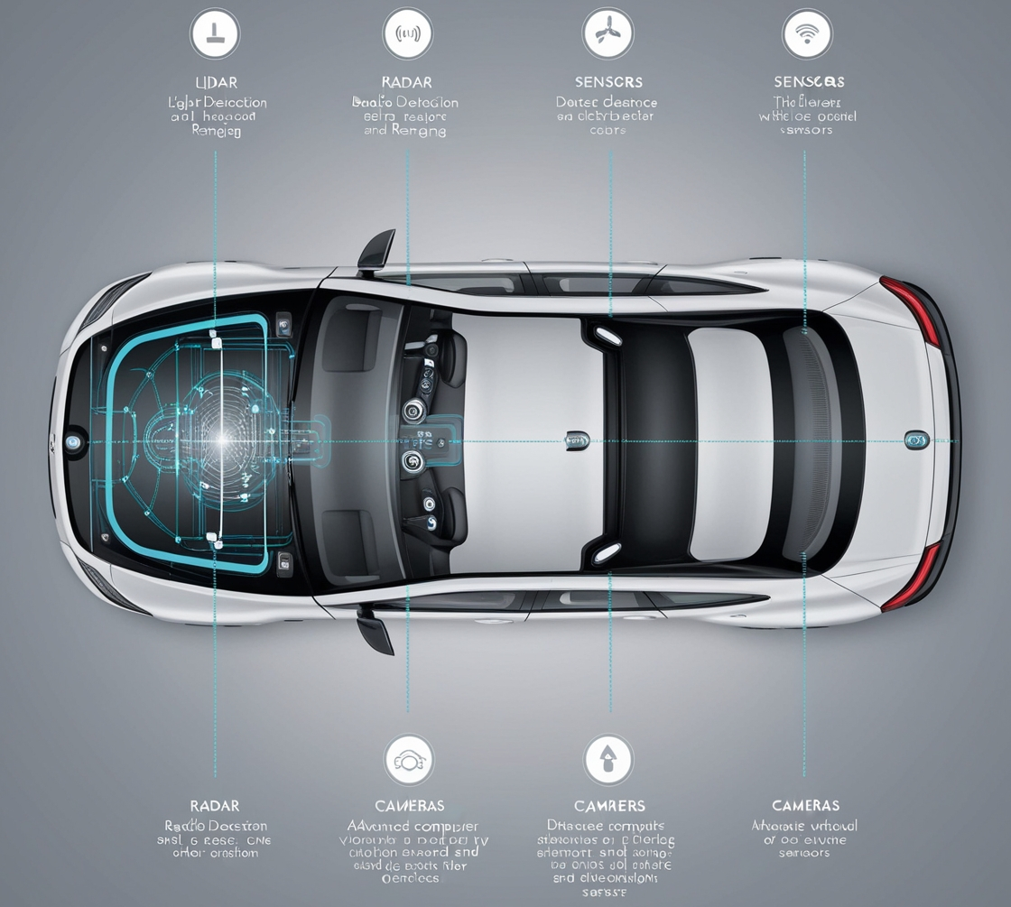
CORE COMPONENTS
1)Sensors:
LiDAR (Light Detection and Ranging): This technology emits laser beams to create a detailed 3D map of the surrounding environment, measuring distances to objects with incredible precision. It can detect obstacles like pedestrians, cyclists, and other vehicles, even in low-light conditions.
Radar (Radio Detection and Ranging): Using radio waves, radar can detect objects, estimate their speed and direction, and penetrate fog, rain, and other adverse weather conditions.
Cameras: These capture visual information of the road, traffic signs, pedestrians, and other vehicles. Advanced computer vision algorithms analyze these images to identify objects and understand traffic situations.
Ultrasonic Sensors: These short-range sensors, often found in the bumpers, detect obstacles very close to the vehicle, such as parking barriers or other cars in a parking lot.

Slide 8
CORE COMPONENTS
2) Artificial Intelligence (AI):
Machine Learning: This enables the vehicle to learn from vast amounts of data, improving its decision-making capabilities over time. It can recognize patterns in traffic, weather conditions, and road signs, allowing it to adapt to different driving scenarios.
Computer Vision: This technology allows the vehicle to interpret visual information from cameras, recognizing objects, traffic signs, and lane markings. It can also detect pedestrians, cyclists, and other road users.
Deep Learning: A subset of machine learning, deep learning uses artificial neural networks to process complex data, such as recognizing pedestrians and cyclists in challenging lighting conditions or obscured by other objects.

Slide 9
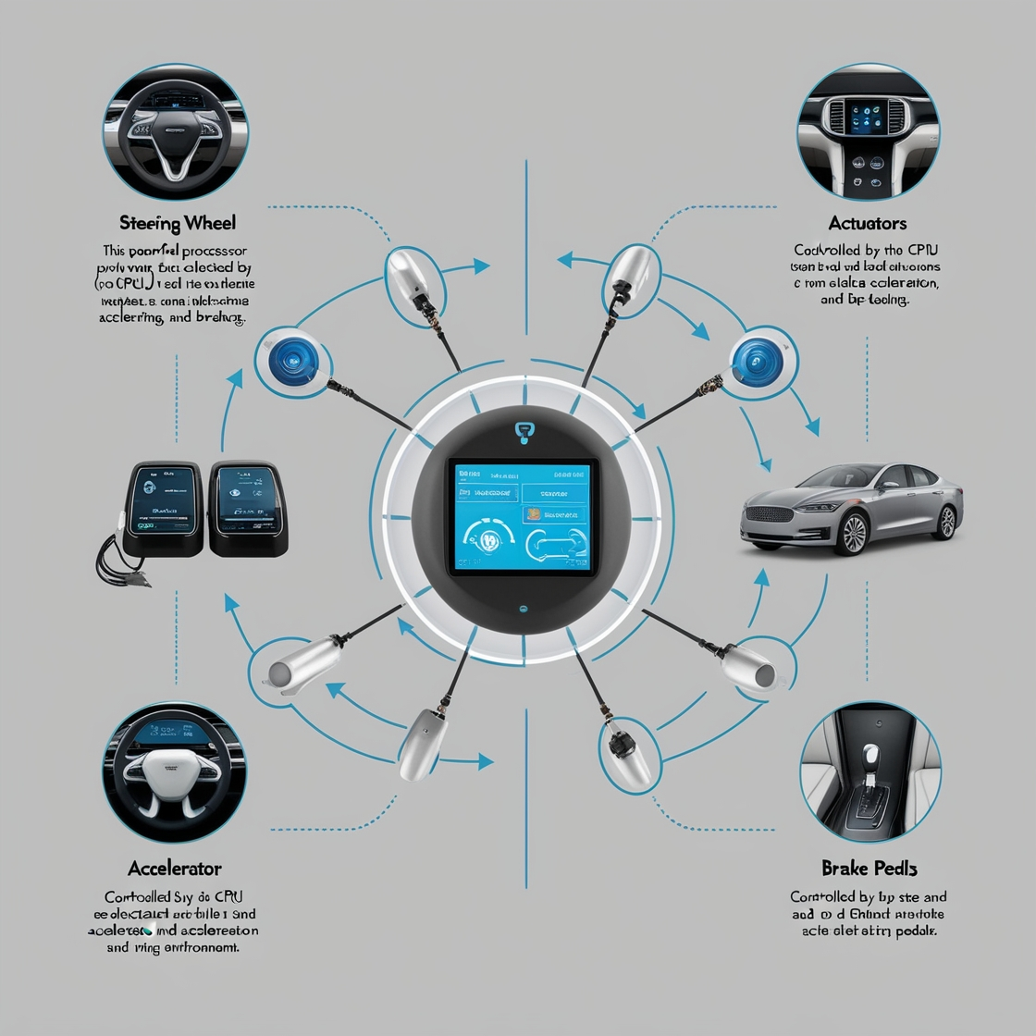
CORE COMPONENTS
3) Central Processing Unit (CPU):
This powerful processor processes the data collected by the sensors and makes real-time decisions about steering, acceleration, and braking. It integrates information from multiple sensors to create a comprehensive understanding of the driving environment.
4)Actuators:
Steering Wheel: Controlled by the CPU to steer the vehicle precisely.
Accelerator and Brake Pedals: Controlled by the CPU to accelerate and decelerate the vehicle smoothly and safely.

Slide 10
DRIVING MECHANISM
Driverless cars utilize a sophisticated network of interconnected systems:
Perception: A suite of sensors, including lidar (Light Detection and Ranging), radar, ultrasonic sensors, and cameras, capture data about the vehicle's surroundings. Lidar provides precise 3D point cloud data, while radar excels in adverse weather conditions. Sensor fusion algorithms combine this data to create a comprehensive environmental model.
Localization: GNSS (Global Navigation Satellite Systems) receivers, coupled with inertial measurement units (IMUs), provide accurate positioning information. This is further refined through simultaneous localization and mapping (SLAM) techniques, which utilize sensor data to build and update a map of the environment.

Slide 11
DRIVING MECHANISM
Path Planning: Algorithms such as A* search and Dijkstra's algorithm are used to generate optimal trajectories, taking into account obstacle avoidance, traffic flow, and road regulations. Motion planning techniques, including cubic splines and Bézier curves, ensure smooth and efficient vehicle movement.
Decision Making: Artificial intelligence, particularly deep neural networks, play a crucial role in interpreting sensor data, predicting the behavior of other road users, and making driving decisions in real-time. Reinforcement learning techniques are employed to optimize decision-making policies.
Control: Actuators, including steering, braking, and acceleration systems, are precisely controlled by electronic control units (ECUs) to execute the planned trajectory and maintain vehicle stability.

Slide 12
SUCCESS
Technological Advancements: Significant progress has been made in sensor technology, AI, and machine learning, enabling vehicles to perceive the environment accurately and make intelligent decisions.
Reduced Accidents: Autonomous vehicles have the potential to significantly reduce accidents caused by human error, such as distracted driving or impaired driving.
Increased Efficiency: Autonomous vehicles can optimize traffic flow, reduce congestion, and improve fuel efficiency.

Slide 13
FAILURES AND REASONS
1. Technological Limitations:
Sensor Limitations: Sensors like LiDAR, radar, and cameras can be affected by adverse weather conditions, lighting, and other environmental factors, leading to inaccurate perception of the surroundings.
AI and Machine Learning Challenges: AI algorithms can struggle to accurately interpret complex and unpredictable traffic situations, especially in edge cases.
Cybersecurity Risks: Autonomous vehicles are vulnerable to cyberattacks, which could compromise their safety and security.

Slide 14
FAILURES AND REASONS
2. Infrastructure Challenges:
Road Infrastructure: Many roads are not designed for autonomous vehicles, lacking proper markings, signs, and sensors.
Traffic Management: Integrating autonomous vehicles into existing traffic systems can be complex and requires careful coordination.

Slide 15
FAILURES AND REASONS
3. Public Perception and Acceptance:
Fear and Uncertainty: Some people are hesitant to trust autonomous vehicles due to concerns about safety and reliability.
Job Displacement: The potential loss of jobs in the transportation industry can lead to social and economic challenges.

Slide 16
FAILURES AND REASONS
4. Ethical Dilemmas:
Decision-Making in Complex Scenarios: Autonomous vehicles may face ethical dilemmas in situations where they must make life-or-death decisions.
5. Regulatory Hurdles:
Complex Regulations: The regulatory landscape for autonomous vehicles is complex and varies by region. Obtaining necessary permits and approvals can be a lengthy and challenging process.
Liability Issues: Determining liability in accidents involving autonomous vehicles can be complex and contentious.

Slide 17
SPECIFIC FAILURES AND INCIDENTS
Uber's 2018 Fatality: The failure of the autonomous system to correctly identify a pedestrian, coupled with inadequate safety driver oversight, resulted in a tragic accident, highlighting the need for robust sensor fusion and fail-safe mechanisms.
Tesla Autopilot Accidents: Overreliance on Level 2 autonomy features, coupled with driver inattention and system limitations in handling complex scenarios, have contributed to accidents, emphasizing the importance of clear communication regarding system capabilities and driver responsibilities.
Waymo Incidents: Waymo's self-driving cars have been involved in accidents, highlighting the challenges of navigating complex traffic situations.
Tesla Autopilot Accidents: Several accidents involving Tesla vehicles using Autopilot have raised concerns about the safety and reliability of autonomous driving systems.

Slide 18
WHY NOT IN INDIA
1. Infrastructure and Road Conditions:
Poor Road Quality: India's road infrastructure, especially in rural areas, is often in poor condition, with potholes, uneven surfaces, and inadequate markings. This can pose significant challenges for autonomous vehicles, which rely on precise sensor data to navigate.
Traffic Congestion: Indian cities are notorious for their heavy traffic, with frequent traffic jams and unpredictable traffic patterns. This can make it difficult for autonomous vehicles to navigate safely and efficiently.
Lack of Standardized Road Signs and Markings: Inconsistent and often non-existent road signs and markings can further complicate the task of autonomous vehicle navigation.

Slide 19
WHY NOT IN INDIA
2. Regulatory Hurdles:
Complex Regulatory Environment: India's regulatory framework for autonomous vehicles is still evolving, and there are concerns about potential legal liabilities and insurance issues.
Data Privacy and Security: The collection and processing of vast amounts of data by autonomous vehicles raise concerns about data privacy and cybersecurity.

Slide 20
WHY NOT IN INDIA
3. Public Perception and Acceptance:
Cultural and Social Factors: Indian culture often prioritizes human interaction and trust in human drivers. This can lead to skepticism and resistance towards autonomous vehicles.
Job Security Concerns: The potential job losses for drivers, especially in the transportation sector, could lead to social and economic challenges.

Slide 21
WHY NOT IN INDIA
4. Technological Limitations:
Sensor Limitations: While sensor technology has advanced significantly, it may still struggle to accurately perceive and interpret complex Indian traffic scenarios, especially in low-visibility conditions or adverse weather.
AI and Machine Learning Challenges: Training AI algorithms to handle the diverse and unpredictable nature of Indian traffic can be a complex task.
5. Government Stance:
Job Protection: The Indian government has expressed concerns about the potential job losses associated with driverless cars and has indicated a cautious approach to their adoption.

Slide 22
LATEST INNOVATIONS AND TRENDS
Advanced Sensor Fusion: Combining data from multiple sensors, such as LiDAR, radar, and cameras, to create a more accurate and comprehensive understanding of the driving environment.
Artificial Intelligence and Machine Learning: Leveraging AI and ML to improve the decision-making capabilities of autonomous vehicles, enabling them to adapt to complex and unpredictable situations.
Edge Computing: Processing data locally within the vehicle to reduce latency and improve real-time response times.
High-Definition Maps: Using detailed maps with precise lane-level information to guide autonomous vehicles with greater accuracy.
Vehicle-to-Vehicle (V2V) and Vehicle-to-Infrastructure (V2I) Communication: Enabling vehicles to communicate with each other and with infrastructure, such as traffic lights and road signs, to enhance safety and efficiency.

Slide 23
CHALLENGES AND FUTURE OUTLOOKS
Despite significant advancements, several challenges remain:
Ethical Considerations: Developing ethical frameworks for autonomous vehicles to make complex decisions in challenging scenarios.
Regulatory Hurdles: Navigating complex regulatory landscapes to ensure the safe deployment of autonomous vehicles.
Public Perception: Addressing public concerns and building trust in autonomous vehicle technology.
The future of driverless cars holds immense potential to transform transportation, reduce accidents, and improve mobility for everyone. As technology continues to advance, we can expect to see increasingly sophisticated and reliable autonomous vehicles on our roads.

Slide 24
CONCLUSION
Autonomous vehicles hold immense potential to transform transportation, offering significant benefits in safety, efficiency, and accessibility. However, addressing the technical, ethical, and societal challenges is crucial to ensure the responsible and successful integration of this technology into our world.

Slide 25
THANK YOU!

